Slide 1


10/31/2012
.. Edusat soety

Slide 2

INTRODUCTION
A digital signal is superior to an analog signal because it is more robust to noise and can easily be recovered, corrected and amplified. For this reason, the tendency today is to change an analog signal to digital data.
The process of transmitting signals in the form of pulses (discontinuous signals) by using special techniques.
10/31/2012

Slide 3
PULSE MODULATION INCLUDES
Pulse Amplitude Modulation
Pulse Width Modulation
Pulse Position Modulation
Pulse Code Modulation
Delta Modulation
10/31/2012

Slide 4
PULSE MODULATION
Analog Pulse Modulation
Digital Pulse Modulation
Pulse Amplitude (PAM)
Pulse Code (PCM)
Pulse Width (PWM)
Delta Modulation(DM)
Pulse Position (PPM)
10/31/2012

Slide 5
Sampling
The process of transmitting signals in the form of pulses (discontinuous signals) by using special techniques.
The signal is sampled at regular intervals such that each sample is propotional to the amplitude of signal at that instant.This technique is called “sampling”.
Sampling is common in all pulse modulation techniques.
10/31/2012

Slide 6
Sampling
Analog signal is sampled every T_{S} secs.
T_{s} is referred to as the sampling interval.
f_{s} = 1/T_{s} is called the sampling rate or sampling frequency.
There are 3 sampling methods:
  Ideal - an impulse at each sampling instant
  Natural - a pulse of short width with varying amplitude
  Flat top - sample and hold, like natural but with single amplitude value
10/31/2012

Slide 7

Three different sampling methods for PCM
10/31/2012
4.<number>

Slide 8
Sampling Rate
Nyquist showed that it is possible to reconstruct a band-limited signal from periodic samples, as long as the sampling rate is at least twice the frequency of the of highest frequency component of the signal i.e. fs ≥ 2fm
where fs is sampling rate
Sampling rates that are too low result in aliasing or foldover
10/31/2012

Slide 9
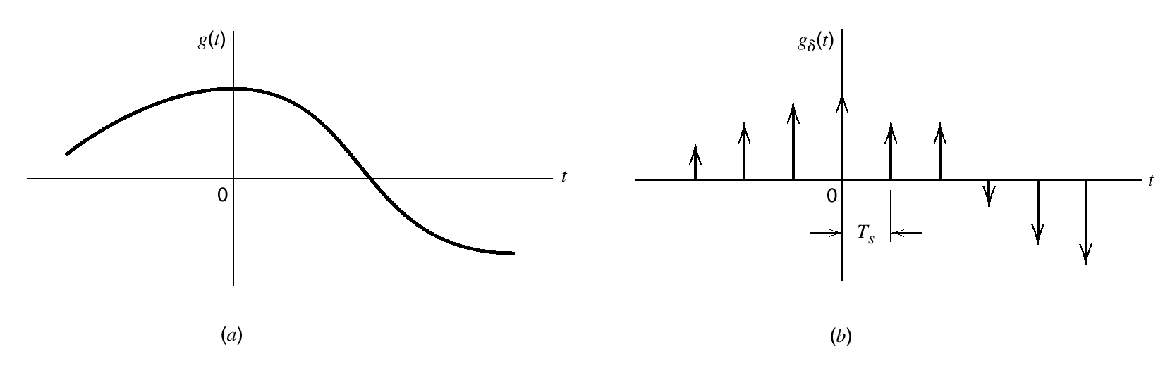
Sampling
10/31/2012

Slide 10
Sampling
Sampling alone is not a digital technique
The immediate result of sampling is a pulse-amplitude modulation (PAM) signal
PAM is an analog scheme in which the amplitude of the pulse is proportional to the amplitude of the signal at the instant of sampling
Another analog pulse-forming technique is known as pulse-duration modulation (PDM). This is also known as pulse-width modulation (PWM)
Pulse-position modulation is closely related to PDM
10/31/2012

Slide 11
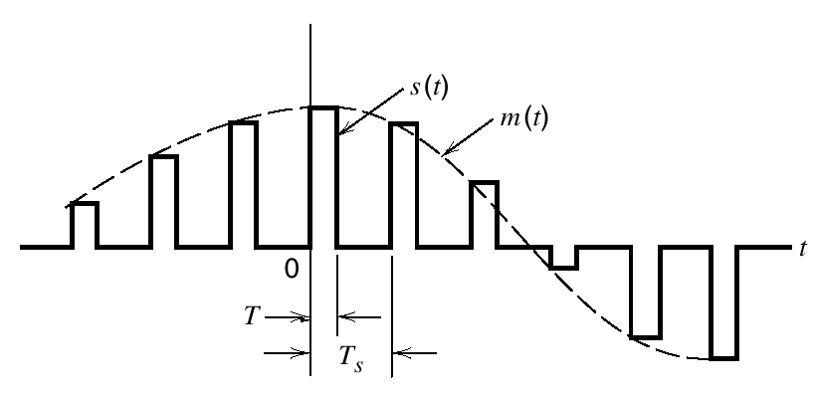
Pulse Amplitude Modulation
In PAM,amplitude of pulses is varied in accordance with instantaneous value of modulating signal.
10/31/2012

Slide 12
Pulse Amplitude Modulation
The carrier is in the form of narrow pulses having frequency fs.The uniform sampling takes place in multiplier to generate PAM signal.Samples are placed Ts sec away from each other.
Modulating Signal
Low Pass Filter
Multiplier
PAM
Signal
Pulse train generator
10/31/2012

Slide 13
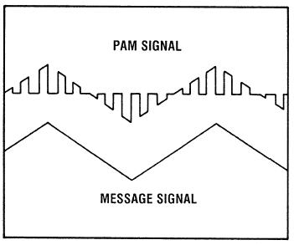
Pulse Amplitude Modulation
Depending upon the shape and polarity of the sampled pulses, PAM is of two types,
Natural PAM sampling occurs when top portion of the pulses are subjected to follow the modulating wave.
10/31/2012

Slide 14
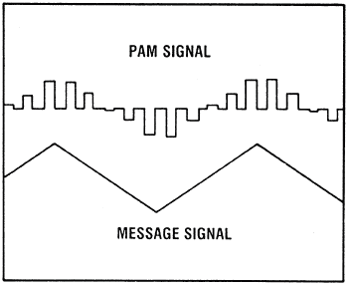
Pulse Amplitude Modulation
Flat topped PAM sampling is often used because of the ease of generating the modulated wave. In this pulses have flat tops after modulation.
10/31/2012

Slide 15
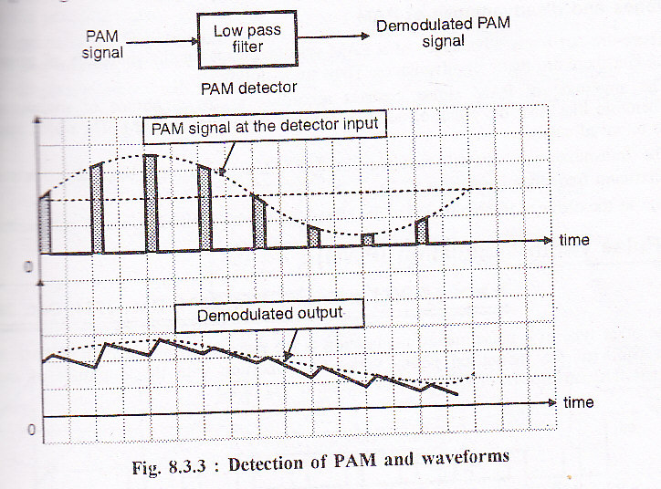
Pulse Amplitude Modulation
The PAM signal can be detected by passing it through a low pass filter.
Fig
10/31/2012

Slide 16
Pulse Width Modulation
In this type, the amplitude is maintained constant but the width of each pulse is varied in accordance with instantaneous value of the analog signal.
10/31/2012

Slide 17
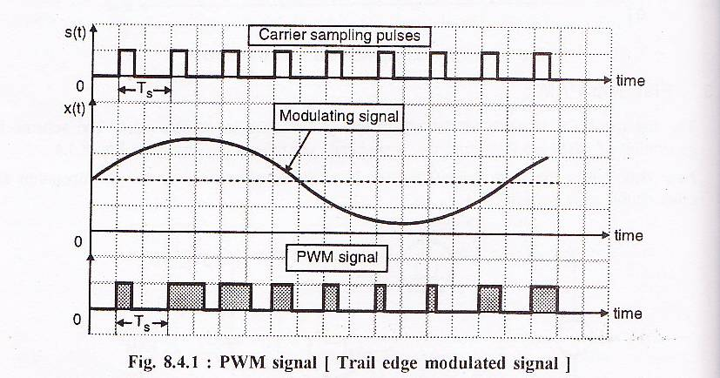
Pulse Width Modulation
Fig:
10/31/2012

Slide 18
Pulse Width Modulation
That is why the information is contained in width variation. This is similar to FM.
In pulse width modulation (PWM), the width of each pulse is made directly proportional to the amplitude of the information signal.
10/31/2012

Slide 19
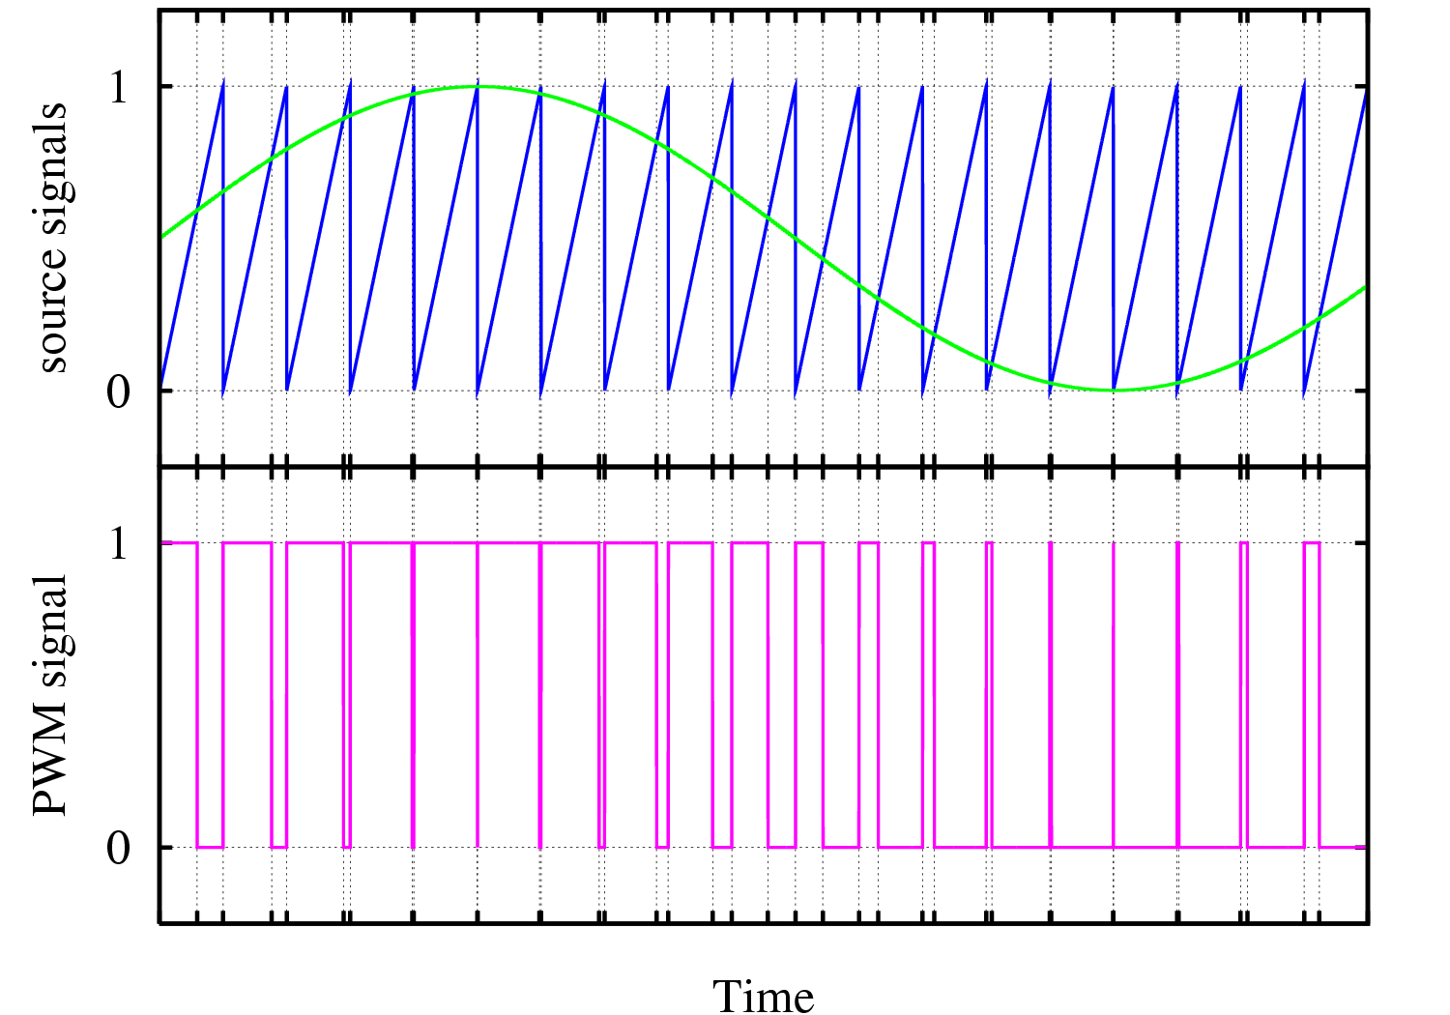
Pulse Width Modulation
10/31/2012

Slide 20
Pulse Width Modulation
A simple method to generate the PWM pulse train corresponding to a given signal is the intersective PWM: the signal (here the green sinewave) is compared with a sawtooth waveform (blue). When the latter is less than the former, the PWM signal (magenta) is in high state (1). Otherwise it is in the low state (0).
10/31/2012

Slide 21
Pulse Width Modulation
The block diagram of next slide can be used for generation of PWM as well as PPM.In this case a sawtooth signal of frequency fs is a sampling signal.
It is applied to inverting terminal of a comparator with modulating signal at non inverting terminal.
O/P remains high as long as modulating signal is higher than that of ramp signal.
10/31/2012

Slide 22
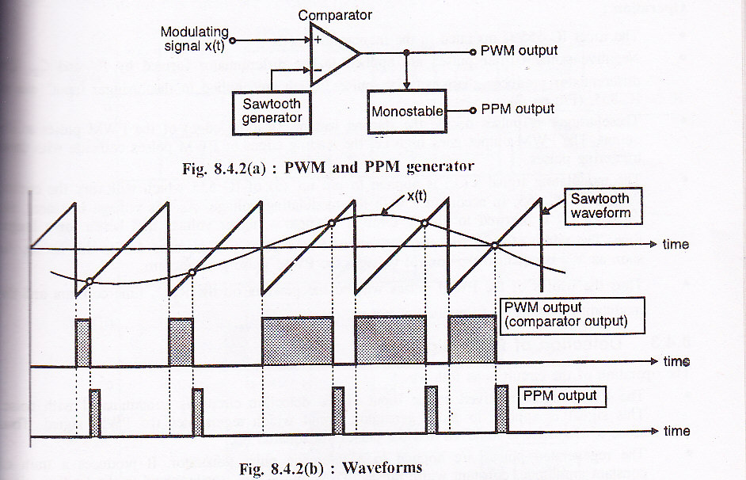
Pulse Width Modulation
10/31/2012

Slide 23
Pulse Position Modulation
In this type, the sampled waveform has fixed amplitude and width whereas the position of each pulse is varied as per instantaneous value of the analog signal.
PPM signal is further modification of a PWM signal.
10/31/2012

Slide 24
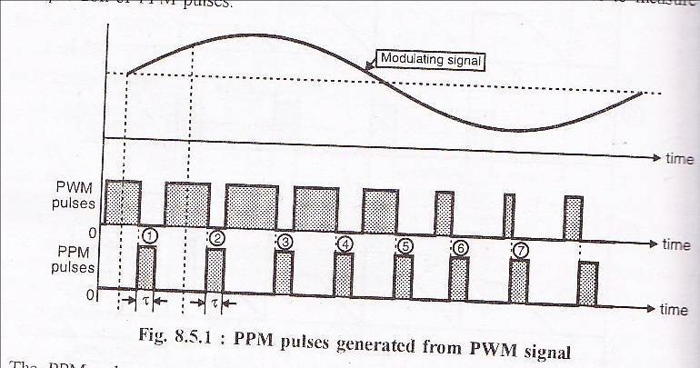
Pulse Position Modulation
10/31/2012

Slide 25
Pulse Position Modulation
The vertical dotted lines shown in last slide treated as reference lines.
The PPM pulses marked 1,2 and 3 go away from their respective reference lines.This corresponds to increase in modulating signal amplitude.
Then as modulating signal decreases the PPM pulses 4,5,6,7 come closer to their respective reference lines.
10/31/2012

Slide 26
Pulse Position Modulation
The PPM signal can be generated from PWM signal.
The PWM pulses obtained at the comparator output are applied to a monostable multivibrator which is –ve edge
triggered.
Hence for each trailing edge of PWM signal, the monostable output goes high.It remains high for a fixed time decided by its own RC components.
10/31/2012

Slide 27
Pulse Position Modulation
Thus as the trailing edges of the PWM signal keeps shifting in propotion with the modulating signal,the PPM pulses also keep shifting.
Therefore all the PPM pulses have the same amplitude and width.The information is conveyed via changing position of pulses.
10/31/2012

Slide 28
Digital Pulse Modulation
Merits of Digital Communication:
1.Digital signals are very easy to receive. The receiver has to just detect whether the pulse is low or high.
2.AM & FM signals become corrupted over much short distances as compared to digital signals. In digital signals, the original signal can be reproduced accurately.
10/31/2012

Slide 29
Digital Pulse Modulation
Merits of Digital Communication
3.The signals lose power as they travel, which is called attenuation. When AM and FM signals are amplified, the noise also get amplified. But the digital signals can be cleaned up to restore the quality and amplified by the regenerators.
4.The noise may change the shape of the pulses but not the pattern of the pulses.
10/31/2012

Slide 30
Digital Pulse Modulation
Merits of Digital Communication:
5.AM and FM signals can be received by any one by suitable receiver. But digital signals can be coded so that only the person, who is intended for, can receive them.
6.AM and FM transmitters are ‘real time systems’. i.e. they can be received only at the time of transmission. But digital signals can be stored at the receiving end.
7.The digital signals can be stored.
10/31/2012

Slide 31
Digital Pulse Modulation
The process of Sampling which we have already discussed in initial slides is also adopted in Digital pulse modulation.
It is mainly of two types:
Pulse Code Modulation(PCM)
Delta Modulation(DM)
10/31/2012

Slide 32
Pulse Code Modulation(PCM)
Pulse-Code Modulation (PCM) is the most commonly used digital modulation scheme
In PCM, the available range of signal voltages is divided into levels and each is assigned a binary number
Each sample is represented by a binary number and transmitted serially
The number of levels available depends upon the number of bits used to express the sample value
The number of levels is given by: N = 2^{m}
10/31/2012

Slide 33
Pulse Code Modulation(PCM)
PCM consists of three steps to digitize an analog signal:
  Sampling
  Quantization
  Binary encoding
Before we sample, we have to filter the signal to limit the maximum frequency of the signal .Filtering should ensure that we do not distort the signal, ie remove high frequency components that affect the signal shape.
10/31/2012

Slide 34
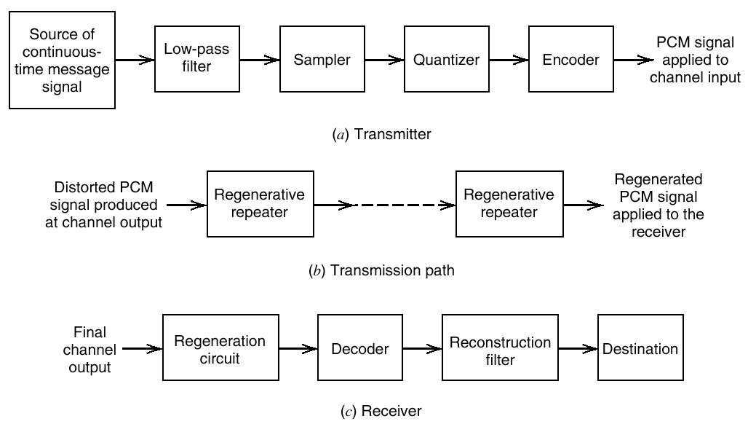
Pulse Code Modulation(PCM)
The basic elements of a PCM system.
10/31/2012

Slide 35
Pulse Code Modulation(PCM)
Analog to digital converter employs two techniques:
1. Sampling: The process of generating pulses of zero width and of amplitude equal to the instantaneous amplitude of the analog signal. The no. of pulses per second is called “sampling rate”.
10/31/2012

Slide 36
Pulse Code Modulation(PCM)
2. Quantization: The process of dividing the maximum value of the analog signal into a fixed no. of levels in order to convert the PAM into a Binary Code.
The levels obtained are called “quanization levels”.
10/31/2012

Slide 37
Voltage
Sampling, Quantization and Coding
Time
76543210
111 110 101 100 011 010 001 000
Binary
Levels
Codes
Time
Voltage
0 1 0 1 0 1 1 1 0 1 1 1 1 1 0 1 0 1 0 1 0
10/31/2012
Time

Slide 38

Pulse Code Modulation(PCM)
10/31/2012

Slide 39
Quantization
By quantizing the PAM pulse, original signal is only approximated
The process of converting analog signals to PCM is called quantizing
Since the original signal can have an infinite number of signal levels, the quantizing process will produce errors called quantizing errors or quantizing noise
10/31/2012

Slide 40
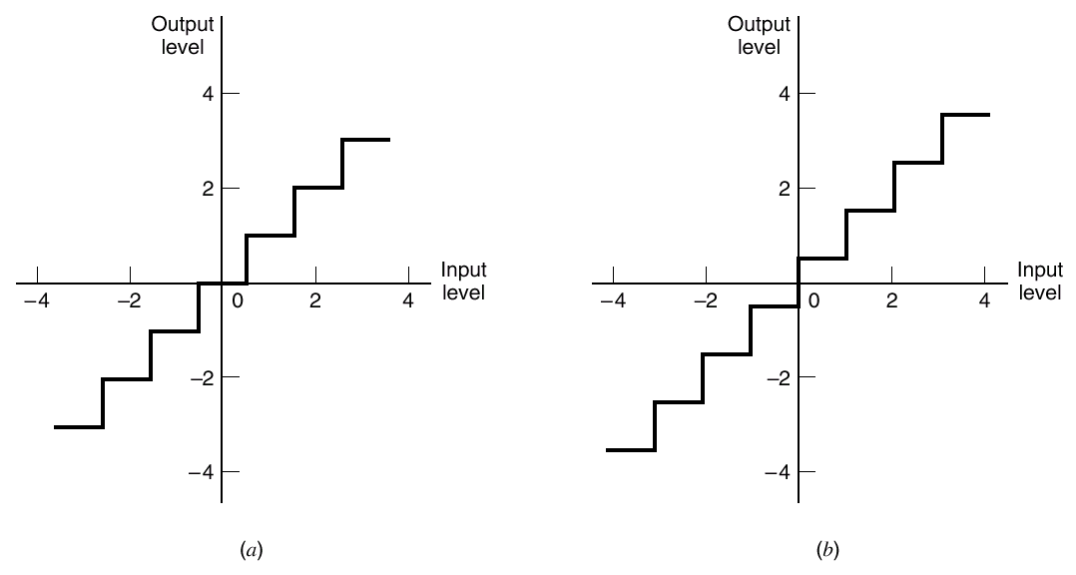
Quantization
Two types of quantization: (a) midtread and (b) midrise
10/31/2012

Slide 41
Quantization
Coding and Decoding
The process of converting an analog signal into PCM is called coding, the inverse operation is called decoding
Both procedures are accomplished in a CODEC
10/31/2012

Slide 42
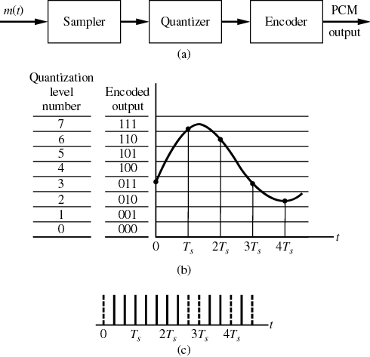
Quantization
10/31/2012

Slide 43
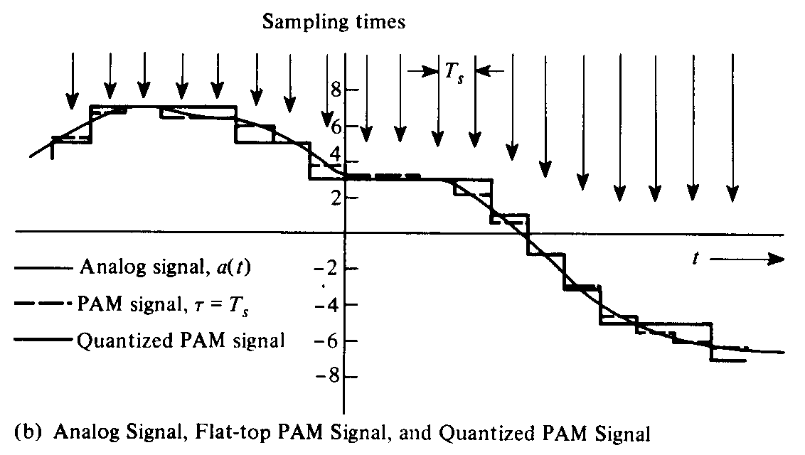
Quantization
10/31/2012

Slide 44

Quantization and encoding of a sampled signal
10/31/2012

Slide 45
Quantization Error
When a signal is quantized, we introduce an error - the coded signal is an approximation of the actual amplitude value.
The difference between actual and coded value (midpoint) is referred to as the quantization error.
The more zones, the smaller Δ which results in smaller errors.
BUT, the more zones the more bits required to encode the samples -> higher bit rate
10/31/2012

Slide 46
Quantization Error (cont.)
Round-off error
Overload error
Overload
10/31/2012

Slide 47
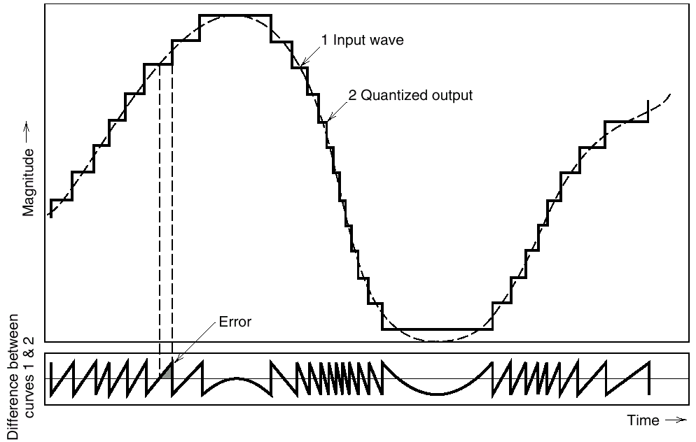
Quantization Noise
Illustration of the quantization process
10/31/2012

Slide 48
Pulse Code Modulation
In PCM system,N number of binary digits are transmitted per sample.Hence the signaling rate and channel bandwidth of PCM are very large.
Also encodind,decoding and quantizing circuitary of PCM is complex.
10/31/2012

Slide 49
Delta Modulation
In Delta Modulation, only one bit is transmitted per sample
That bit is a one if the current sample is more positive than the previous sample, and a zero if it is more negative
Since so little information is transmitted, delta modulation requires higher sampling rates than PCM for equal quality of reproduction
10/31/2012

Slide 50
Delta Modulation
This scheme sends only the difference between pulses, if the pulse at time t_{n+1} is higher in amplitude value than the pulse at time t_{n}, then a single bit, say a “1”, is used to indicate the positive value.
If the pulse is lower in value, resulting in a negative value, a “0” is used.
This scheme works well for small changes in signal values between samples.
If changes in amplitude are large, this will result in large errors.
10/31/2012

Slide 51

Delta Modulation
The process of delta modulation
10/31/2012

Slide 52

Delta Modulation
Components of Delta Modulation
10/31/2012

Slide 53
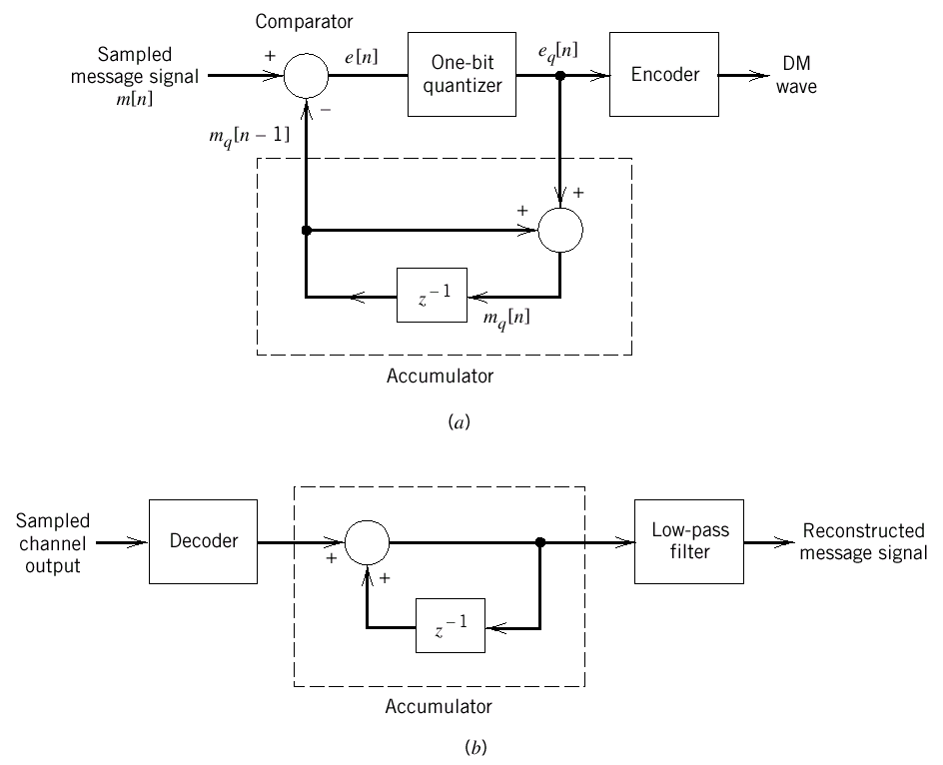
Delta Modulation
DM system. (a) Transmitter. (b) Receiver.
10/31/2012

Slide 54
Delta Modulation
Distortions in DM system
If the slope of analog signal is much higher than that of approximated digital signal over long duration,than this difference is called Slope overload distortion.
The difference between quantized signal and original signal is called as Granular noise. It is similar to quantisation noise.
10/31/2012

Slide 55
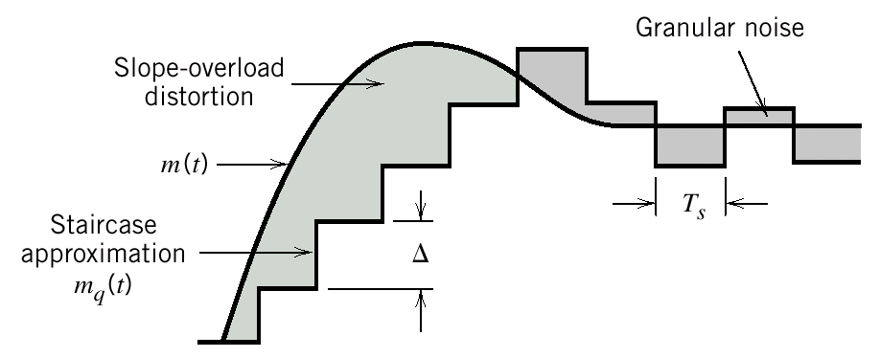
Delta Modulation
Two types of quantization errors :
Slope overload distortion and granular noise
10/31/2012

Slide 56
Delta Modulation
Distortions in DM system
Granular noise occurs when step size▲ is large relative to local slope m(t).
There is a further modification in this system,in which step size is not fixed.
That scheme is known as Adaptive Delta Modulation.
10/31/2012

Slide 57
Adaptive Delta Modulation
A better performance can be achieved if the value of ▲ is not fixed.
The value of ▲ changes according to the amplitude of the analog signal.
It has wide dynamic range due to variable step size.
Also better utilisation of bandwidth as compared to delta modulation.
Improvement in signal to noise ratio.
10/31/2012

Slide 58
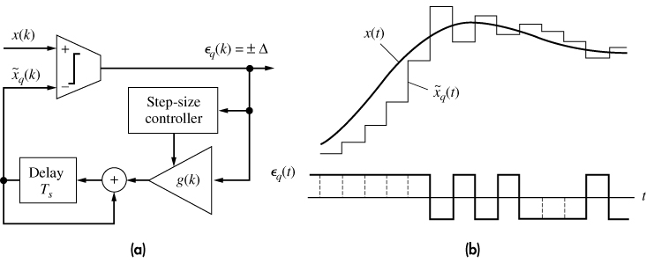
Adaptive Delta Modulation
10/31/2012

Slide 59
Conclusion
The main advantage of these pulse modulation schemes are better noise immunity and possibility of use of repeaters which makes communication more reliable and error free.
10/31/2012

